Slide 1
The Three
Angels’ Messages
Made Simple

Slide 2
But even if we or an angel from heaven should
preach a Gospel contrary to the one we preached to you, let him be accursed.
Galatians 1:8-9

Slide 3
As we said before, so now I say again, if anyone is
preaching to you a Gospel contrary to the one you received, let him be accursed.
Galatians 1:8-9

Slide 4
Then I saw another angel flying in the midst of heaven,
having the everlasting Gospel to proclaim to those who dwell on earth,
Revelation 14:6-7

Slide 5
to every nation and tribe and language and people.
And he said with a loud voice, “Fear God and give glory to Him, because the hour of His judgment has come…
Revelation 14:6-7

Slide 6
and worship Him who mad heaven and earth, the sea, and the springs of water.”
Revelation 14:6-7

Slide 7
and worship Him who mad heaven and earth, the sea, and the springs of water.”
Revelation 14:6-7

Slide 8
Everlasting?
Revelation 14:6-7

Slide 9
Blessed be the God and Father of our Lord Jesus Christ, who has blessed us in Christ with every spiritual blessing in the heavenly places, even as He chose us in Him before the foundation of the world, that we should be holy and blameless before him.
Ephesians 1:3-11

Slide 10
In love He predestined us for adoption to himself as sons through Jesus Christ, according to the purpose of His will, to the praise of His glorious grace, with which He has blessed us in the Beloved.
Ephesians 1:3-11

Slide 11
In Him we have redemption through His blood, the forgiveness of our trespasses, according to the riches of His grace, which He lavished upon us, in all wisdom and insight making known to us the mystery of His will, according to His purpose,
Ephesians 1:3-11

Slide 12
which He set forth in Christ as a plan for the fullness of time, to unite all things in Him, things in heaven and things on earth.
Ephesians 1:3-11

Slide 13
Therefore do not be ashamed of the testimony about our Lord, nor of me his prisoner, but share in suffering for the Gospel by the power of God, who saved us and called us to a holy calling, not because of our works but because of His own purpose and grace
2 Timothy 1:8-11

Slide 14
which He gave us in Christ Jesus before the ages began, and which now has been manifested through the appearing of our Savior Christ Jesus, who abolished death and brought life and immortality to light through the gospel…
2 Timothy 1:8-11

Slide 15
The Gospel is a PROCLAMATION,
Not an
INVITATION

Slide 16
Then I saw another angel flying in the midst of heaven, with an eternal Gospel to
PROCLAIM
to those who dwell on the earth…
Revelation 14:6

Slide 17
OUTLINE OF THE APOSTOLIC GOSPEL
1. Jesus is FULFILLMENT

Slide 18
OUTLINE OF THE APOSTOLIC GOSPEL
Jesus is FULFILLMENT
Jesus is MESSIAH

Slide 19
OUTLINE OF THE APOSTOLIC GOSPEL
Jesus is FULFILLMENT
Jesus is MESSIAH
Jesus LIVED for us

Slide 20
OUTLINE OF THE APOSTOLIC GOSPEL
Jesus is FULFILLMENT
Jesus is MESSIAH
Jesus LIVED for us
Jesus DIED for us

Slide 21
OUTLINE OF THE APOSTOLIC GOSPEL
Jesus is FULFILLMENT
Jesus is MESSIAH
Jesus LIVED for us
Jesus DIED for us
Jesus AROSE for us

Slide 22
OUTLINE OF THE APOSTOLIC GOSPEL
Jesus is FULFILLMENT
Jesus is MESSIAH
Jesus LIVED for us
Jesus DIED for us
Jesus AROSE for us
Jesus ASCENDED for us

Slide 23
OUTLINE OF THE APOSTOLIC GOSPEL
Jesus is FULFILLMENT
Jesus is MESSIAH
Jesus LIVED for us
Jesus DIED for us
Jesus AROSE for us
Jesus ASCENDED for us
Jesus SHALL RETURN for us

Slide 24
OUTLINE OF THE APOSTOLIC GOSPEL
Jesus is FULFILLMENT
Jesus is MESSIAH
Jesus LIVED for us
Jesus DIED for us
Jesus AROSE for us
Jesus ASCENDED for us
Jesus SHALL RETURN for us
We are
HIS
FOREVER

Slide 25
See the Appendixes!

Slide 26
Listening to
Ellen G. White

Slide 27
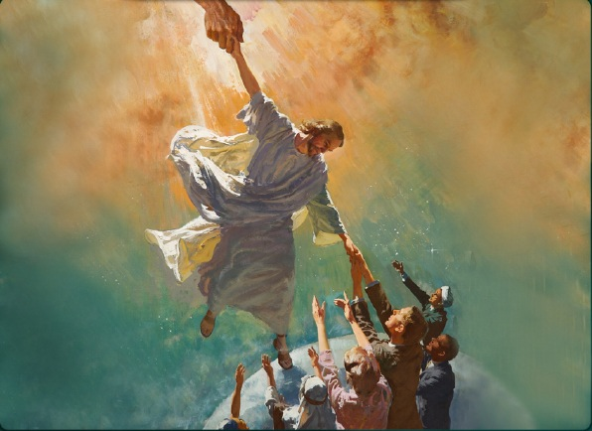
I BELIEVE IN YOU, LORD JESUS...

Slide 28
I BELIEVE IN YOU, LORD JESUS...
You FULFILLED
God’s Promises
to ME

Slide 29
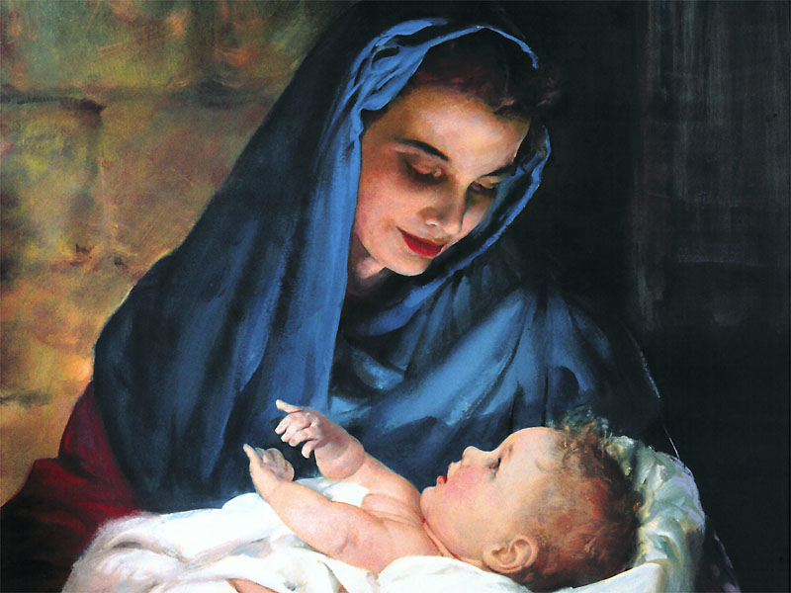
You are the
MESSIAH,
the SON OF GOD,
MY SAVIOR

Slide 30
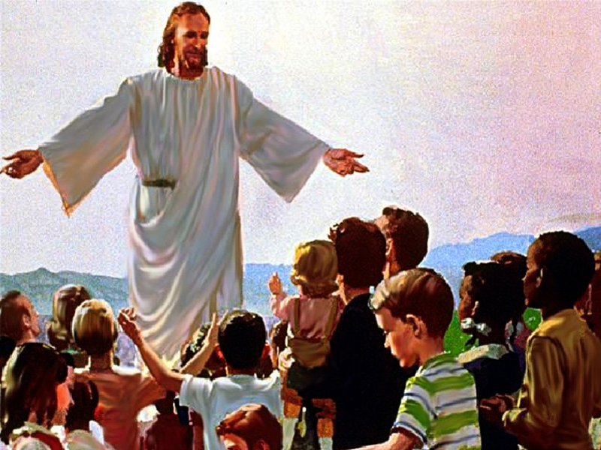
You
LIVED
for ME

Slide 31
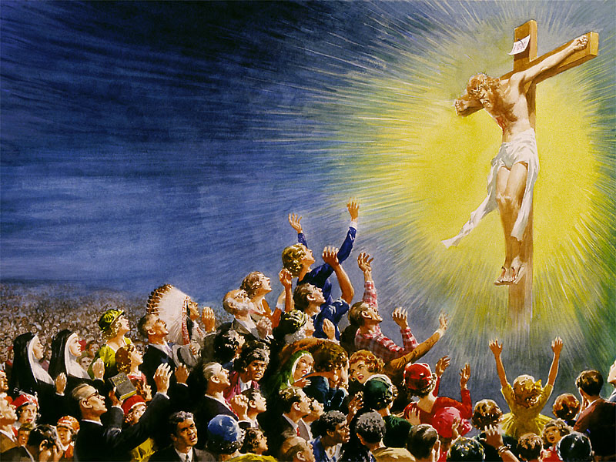
You
DIED
for ME

Slide 32
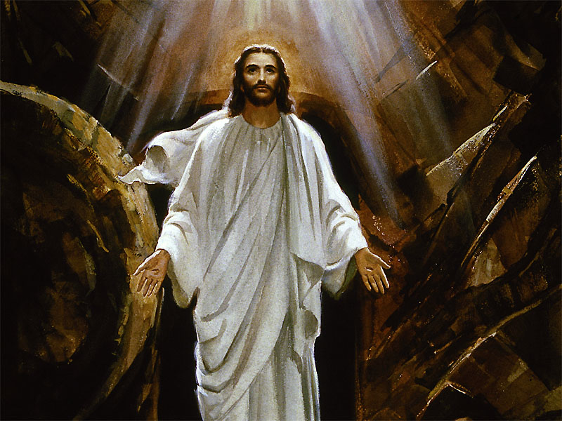
You AROSE for ME

Slide 33
You ASCENDED for ME

Slide 34
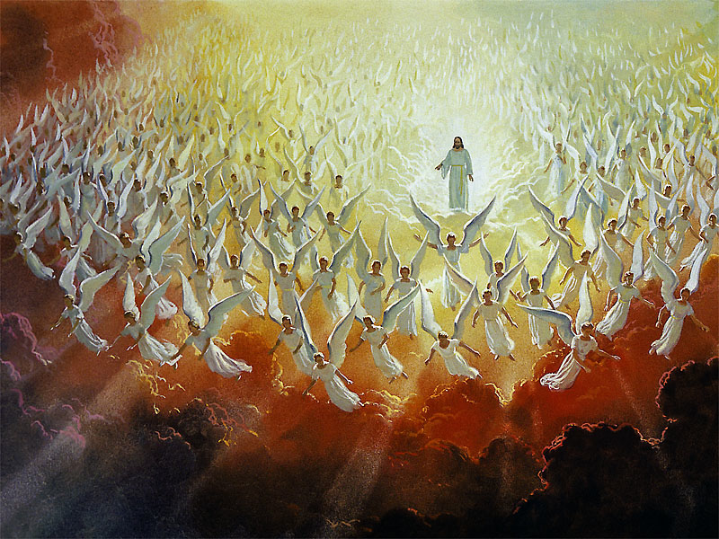
You SHALL RETURN for ME

Slide 35
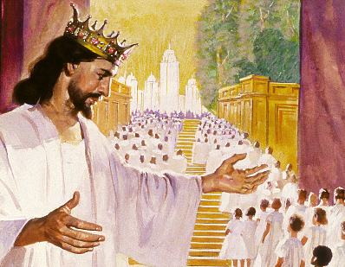
And I AM YOURS forever

